Slide 1
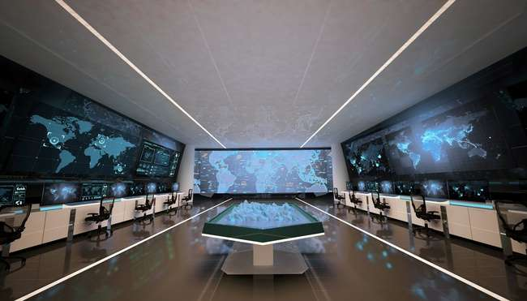
SMART MILITARY BASES

Slide 2
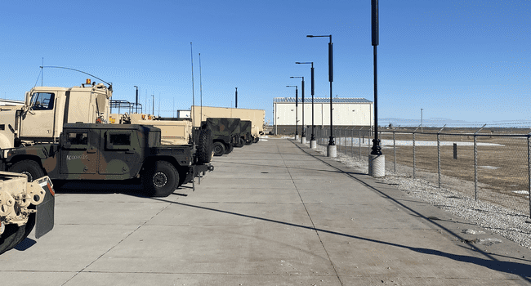

Slide 3
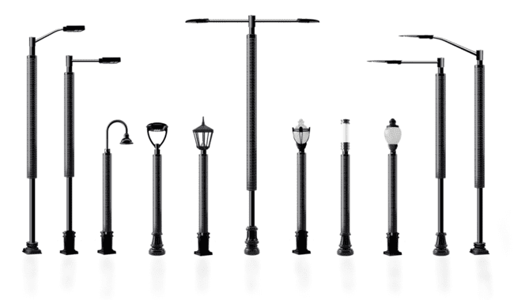

Slide 4

FACIAL RECONGNITION
CAMERA OPTIONS
  2MP
  4MP
PTZ CAMERA
LICENSE PLATE READER (LPR)
  1920 X 1080 RESOLUTION
  2048 X 1536 RESOLUTION
WIFI OPTIONS
  2.4GHz
  5.0GHz
USB CHARGER
GUNSHOT DETECTION
MOTION SENSORS
ENIVRONMENTAL SENSORS
EMERGENCY CALL BUTTON

Slide 5
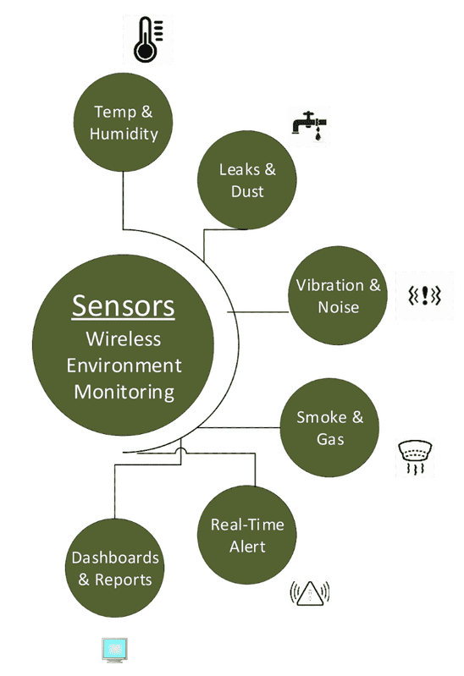


TEMPERATURE SENSOR
UV DETECTOR
HUMIDITY SENSOR
PRESSURE SENSOR
GAS SENSOR
SUNLIGHT SENSOR
  INFRARED LIGHT
  VISIBLE LIGHT
  UV LIGHT
AIR QUALITY SENSOR
FLOOD SENSOR
DUST SENSOR

Slide 6
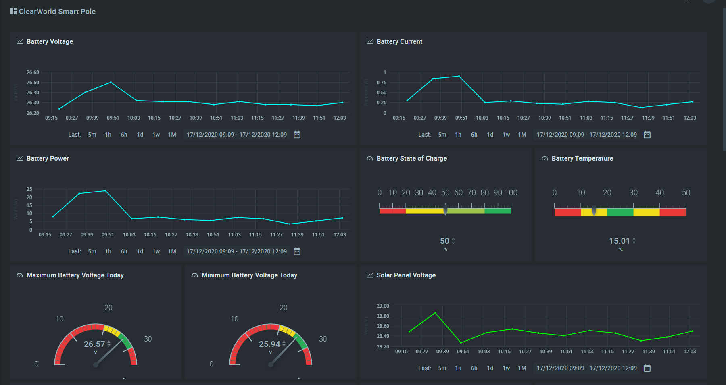



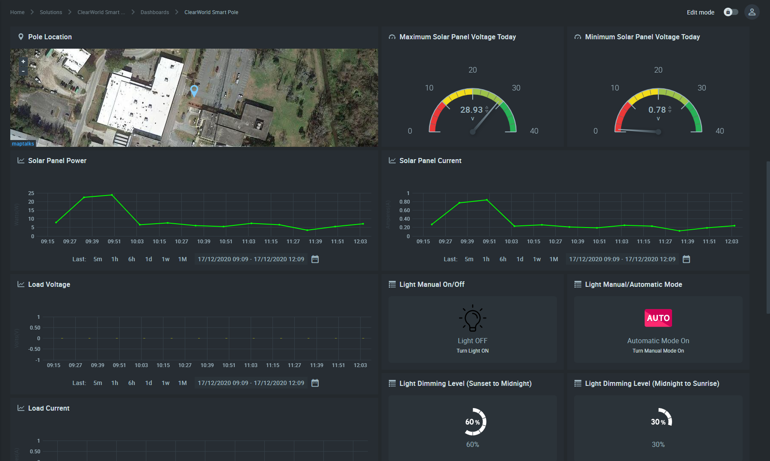


SMART DASHBOARD

Slide 7
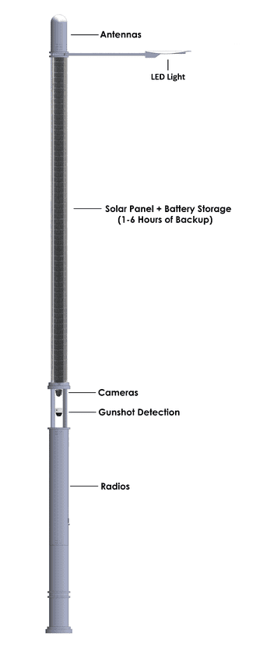



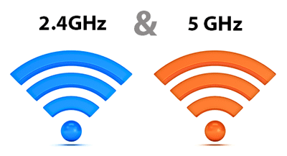







CONNECTIVITY
&

